Slide 1
컴퓨터 네트워크 Computer Networks and Internets, 6e

Slide 2
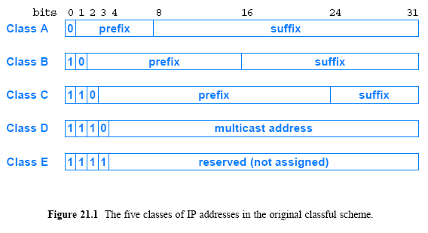
21.5 Original Classes of IP Addresses

Slide 3
Assignment
Will the Internet be replaced by a single networking technology? Why or why not?
If an ISP assigned you with a /28 address block(178.25.0.16/28), how many computers could you assign an address? Show the addresses assigned to computers.
178.25.0.16/28
11111111 11111111 11111111 11110000
00010000
00010001
----
00011110
00011111
© Pearson Education Inc., Upper Saddle River, NJ. All rights reserved.
3
Notes:
3

Slide 4
Assignment
3. Execute the following network commands, and find out the IP addresses of routers between your computer and www.google.com
tracert www.google.com
© Pearson Education Inc., Upper Saddle River, NJ. All rights reserved.
4
Notes:
4

Slide 5
Chapter 22 Datagram Forwarding

Slide 6
22.1 Introduction
This chapter
discusses the fundamental communication service in the Internet
describes the format of packets that are sent across the Internet
discusses the key concepts of datagram encapsulation, forwarding, and fragmentation and reassembly

Slide 7
22.2 Connectionless Service
In some application, programs remain unaware of the underlying physical networks
they can send/receive data without knowing the details of
the LAN to which a computer connects
the remote network to which the destination connects
What services that will be offered by a network?
connection-oriented service
connectionless service
or a combination of both
TCP/IP include protocols for both
An unreliable connectionless delivery service
A reliable connection-oriented service
that uses the underlying connectionless service
The design forms the basis for all Internet communication

Slide 8
22.3 Virtual Packets
In connectionless each packet travels independently
It contains information that identifies the intended recipient
How does a packet pass across the Internet?
A host
creates a packet
places the destination address in the packet header
and then sends the packet to a nearby router
A router
receives a packet
uses the destination address to select the next router on the path
and then forwards the packet
Eventually, the packet reaches a router that can deliver the packet to its final destination

Slide 9
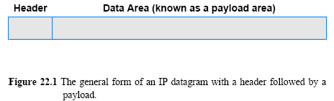
22.4 The IP Datagram
TCP/IP uses the name IP datagram to refer to a packet
Figure 22.1 illustrates an IP datagram format
Each datagram consists of a header followed by data area (payload)
The amount of data carried in a datagram is not fixed
The size of a datagram is determined by the application that sends data
A datagram can contain as little as a single octet of data or at most 64K

Slide 10
22.5 The IP Datagram Header Format
What does a datagram header contain?
It contains information used to forward the datagram
A datagram head contains information, such as:
the address of the source (the original sender)
the address of the destination (the ultimate recipient)
and a field that specifies the type of data being carried in the payload
Each address in the header is an IP address
MAC addresses for the sender and recipient do not appear
Each field in an IP datagram header has a fixed size
which makes header processing efficient
Figure 22.2 shows the fields of an IP datagram header

Slide 11
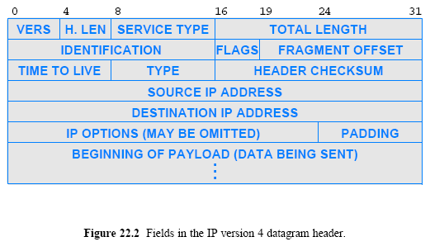
22.5 The IP Datagram Header Format
Service type: reserved(7~6), reliability(5), rate(4), delay (3), priority(2~1)
FLAGS(4): x DF(Don’t Fragm..) MF(More Fragm..) x
Options: code type(1B: copy+class+number), length(1B), option-data(2B,6B,.. )

Slide 12
22.6 Forwarding an IP Datagram
Each datagram handled independently
Datagram formed on source computer
Source sends datagram to nearest router
Router forwards datagram to next router to destination
Final router delivers datagram to destination
Datagram passes across a single physical network at each step
Performed by initial host and each router along path
Selects next hop for the datagram as either
– Next router along the path
– Ultimate destination
Uses a forwarding table with one entry per network

Slide 13
22.6 Forwarding an IP Datagram
Forwarding table contains a set of entries
Destination network IP prefix
Address mask for the destination network
IP address of next hop
Default entry
Each destination in the table corresponds to a network
the number of entries in a forwarding table is proportional to the number of networks in the Internet

Slide 14
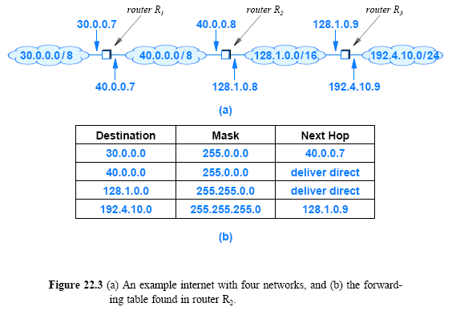
22.6 Forwarding an IP Datagram

Slide 15
22.7 Network Prefix Extraction and Datagram Forwarding
Forwarding paradigm
Use network prefix when forwarding
Use host when delivering
Conceptual forwarding step
Compare destination in each forwarding table entry with datagram’s destination address, D
During comparison, only examine network prefix
Note: mask in forwarding table makes comparison efficient
if ( (Mask[i] & D) == Destination[i] ) forward to NextHop[i];

Slide 16
22.8 Longest Prefix Match
Classless addressing means forwarding table entries can be ambiguous
Example: consider destination 128.10.2.3 and a table that includes the following two entries:
128.10.0.0 / 16 next hop A
128.10.2.0 / 24 next hop B
The destination matches both of them!
Solution: select the match that has the longest prefix (in the example, take next hop B)
Known as longest prefix match

Slide 17
22.10 Best-Effort Delivery
Term best-effort to describe the service of IP protocol
IP makes a best-effort to deliver each datagram
IP does not guarantee that it will handle all problems
The following problems can occur in IP protocol
Datagram duplication
Delayed or out-of-order delivery
Corruption of data
Datagram loss
IP is designed to run over any type of network
network equipment can experience interference from noise
Packets following one path may take longer than those following another path
this can result in out-of-order delivery

Slide 18
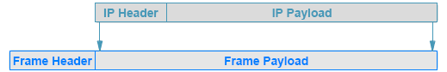
22.11 IP Encapsulation
How can a datagram be transmitted across a physical network that does not understand the datagram format?
The answer lies in a technique known as encapsulation
Needed because underlying network hardware does not understand datagrams
The network hardware treats a frame that contains a datagram exactly like any other frame
hardware does not examine or change the contents of the payload
Figure 22.4 (below) illustrates the concept

Slide 19
IP Datagram

Slide 20
IP Datagram

Slide 21
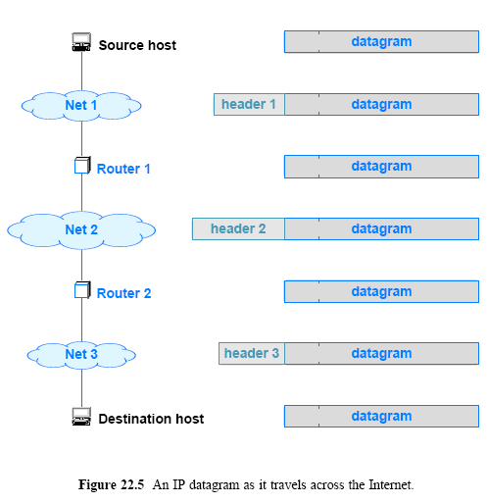
22.12 Transmission Across an Internet

Slide 22
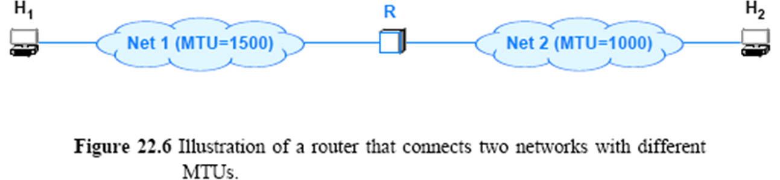
22.13 MTU and Datagram Fragmentation
Each hardware technology specifies the maximum amount of data that a frame can carry
The limit is known as a Maximum Transmission Unit (MTU)
Example: Ethernet MTU is 1500 octets
Datagram can be as large as the network MTU
Consider a 1500-octet datagram set from H1 to H2 in the following network

Slide 23
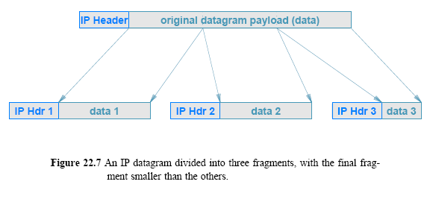
22.13 MTU and Datagram Fragmentation

Slide 24
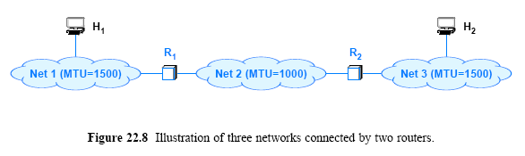
22.14 Reassembly of a Datagram from Fragments
Consider the configuration in Figure 22.8
if host H₁ sends a 1500-octet datagram to host H₂, router R₁ will divide the datagram into two fragments, which it will forward to R₂
Router R₂ does not reassemble the fragments
Instead R uses the destination address in a fragment to forward the fragment as usual
The ultimate destination host, H₂, collects the fragments and reassembles them to produce the original datagram

Slide 25
22.14 Reassembly of a Datagram from Fragments
Requiring the ultimate destination to reassemble fragments has two advantages:
First, it reduces the amount of state information in routers
When forwarding a datagram, a router does not need to know whether the datagram is a fragment
Second, it allows routes to change dynamically
If an intermediate router were to reassemble fragments, all fragments would need to reach the router
By postponing reassembly until the ultimate destination
IP is free to pass some fragments from a datagram along different routes than other fragments
That is, the Internet can change routes at any time
(e.g., to route around a hardware failure)

Slide 26
22.15 Collecting the Fragments of a Datagram
Fragments from multiple datagrams can arrive out-of-order
Individual fragments can be lost or arrive out-of-order
How does it reassemble fragments that arrive out-of-order?
A sender places a unique identification number in the IDENTIFICATION field of each outgoing datagram
A bit in FLAGS field specifies whether given datagram is a fragment or complete datagram
An additional FLAGS bit specifies whether the fragment carries the tail of the original datagram
The FRAGMENT OFFSET field tells a receiver where data in the fragment belongs in the original datagram

Slide 27
Chapter 23 Support Protocols and Technologies

Slide 28
23.1 Introduction
This chapter
continues the discussion of internetworking by introducing four key support technologies:
address binding
error reporting
bootstrapping
address translation
Each technology handles a small problem
When combined with other protocols
each makes a significant contribution to the overall functionality
Future chapters
extend the discussion of internetworking
by focusing on transport layer protocols and Internet routing protocols

Slide 29
Review Of Datagram Transmission
Host or router has datagram to send
IP uses longest-prefix match to look up datagram’s destination address in forwarding table and obtains
– IP address of next hop
– Network over which to send (in case there is more than one network connection)
IP encapsulates datagram in frame (entire datagram placed in payload area of frame)
Is the resulting frame ready to send to the next hop?
No!
– The IP address of the next hop must be translated to a MAC address before a frame can be sent.

Slide 30
23.2 Address Resolution
A crucial step of the forwarding process requires a translation:
forwarding uses IP addresses
a frame transmitted must contain the MAC address of the next hop
IP must translate the next-hop IP address to a MAC address
Translation from a computer's IP address to an equivalent hardware address is known as address resolution
And an IP address is said to be resolved to the correct MAC address
Address resolution is local to a network

Slide 31
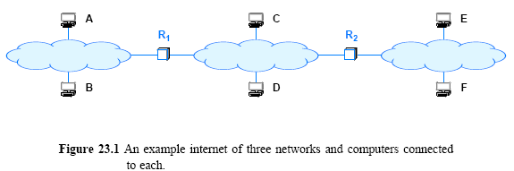
23.2 Address Resolution
One computer can resolve the address of another computer only if both computers attach to the same physical network
A computer never resolves the address of a computer on a remote network
Address resolution is always restricted to a single network.
For example, consider the simple internet in Figure 23.1(A > E)
A MAC address is needed at each hop

Slide 32
23.3 The Address Resolution Protocol (ARP)
Designed for IPv4 over Ethernet
Used by two computers on the same physical network
Allows a computer to find the MAC address of another computer
Operates at layer 2
Uses network to exchange messages
Computer seeking an address sends request
Consider Figure 23.2
Suppose B needs to resolve the IP address of C
B broadcasts a request that says:
The broadcast only travels across one network
An ARP request message reaches all computers on a network
When C receives a copy of the request along other hosts

Slide 33
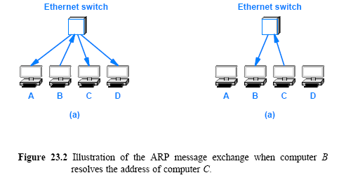
23.3 The Address Resolution Protocol (ARP)

Slide 34
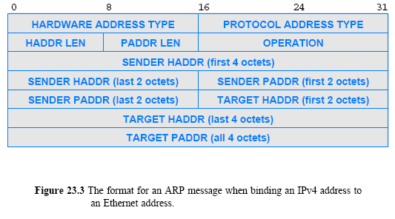
23.4 ARP Message Format

Slide 35
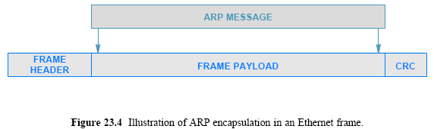
23.5 ARP Encapsulation
When it travels across a physical network
an ARP message is encapsulated in a hardware frame
When used with Ethernet, type is 0x0806
An ARP message is treated as data being transported
Source and destination MAC addresses must be added to frame header before sending

Slide 36
23.6 ARP Caching and Message Processing
Sending an ARP request for each datagram is inefficient
Three (3) frames traverse the network for each datagram
(an ARP request, ARP response, and the data datagram itself)
Most communications involve a sequence of packets
a sender is likely to repeat the exchange many times
To reduce network traffic ARP manages a cache
an entry is replaced when a response arrives
the oldest entry is removed whenever the table runs out of space or after an entry has not been updated for a long period of time
ARP starts by searching the cache when it needs to bind an address

Slide 37
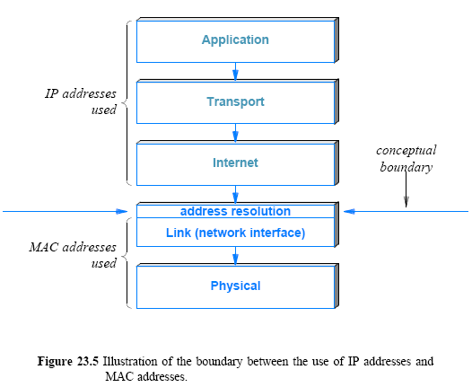
23.7 The Conceptual Address Boundary

Slide 38
Assignment
2. An IP datagram has the following partial information.
45000054 00030000 2006…….
a) What is the size of the header and the data?
b) Is the packet fragmented?
c) What is the protocol number of the payload being carried by the packet?
d) How many more routers can the packet travel to?
2. An IP fragment has arrived with a fragment offset value of 100. How many bytes of data were originally sent by the source before the data in this fragment?
3. Capture packets using Wireshark, and explain fields in the IP header.
Send your solution to me by email. (Due date: Sat./ 24PM )
This assignment will be used to check your attendance.
© Pearson Education Inc., Upper Saddle River, NJ. All rights reserved.
38
Notes:
38

